Slide 1


Exoplanet Classification
A Machine Learning Approach
Inspired by Kepler Space Telescope Data
Sachin Vishvakarma(211060030)
Shashwat Barai(221060007)

Slide 2
Kepler Telescope monitors star brightness to detect exoplanets
Introduction to Exoplanets
Planets Outside Our Solar System
Exoplanets are crucial for understanding our universe. Detecting and classifying them presents challenges, particularly in distinguishing genuine planets from noise in observational data, particularly from the Kepler mission.
Kepler Telescope monitors star brightness to detect exoplanets.
Machine learning helps classify dips in brightness as planets or non-planets.
Goal: Build a classifier using Kepler-labelled time series dataset.
2

Slide 3
Importance of Exoplanet Classification
01
Detection
03
Kepler Mission
Exoplanets hold clues to understanding our universe.
Provided vast data from thousands of stars.
02
Classification
04
Machine Learning Goal
Accurate classification helps identify potentially habitable worlds.
Our aim is to automate exoplanet classification.

Slide 4
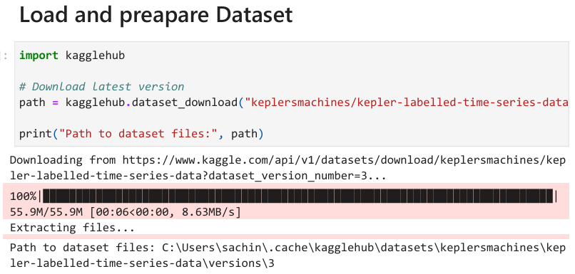

Data and Feature Preparation
Understanding the Dataset and Preprocessing Steps
Dataset Overview
Source: Kaggle – Kepler Labelled Time Series Dataset.
Contains 3197 flux readings per star.
Labels: 0 = Non-Planet, 1 = Planet.
Train Samples: 5087
Test Samples: 570
4

Slide 5
Dataset Preparation Steps
01
Description
03
Feature Extraction
Two datasets contain thousands of flux measurements.
FFT converts time-series data into frequency domain.
02
Label Encoding
04
Data Scaling
Original labels converted to binary format for analysis.
StandardScaler normalization ensures uniform data distribution.

Slide 6
Data Preprocessing
• Removed label column and isolated flux values.
• Applied FFT to convert time-domain light curves into frequency-domain.
• Scaled features using StandardScaler.
• Balanced dataset using SMOTE
Why FFT?
• Light curves contain periodic dips caused by exoplanet movement.
• FFT transforms signals to frequency domain.
• Allows model to learn dominant periodic patterns.
• Reduces noise and increases classification power.

Slide 7
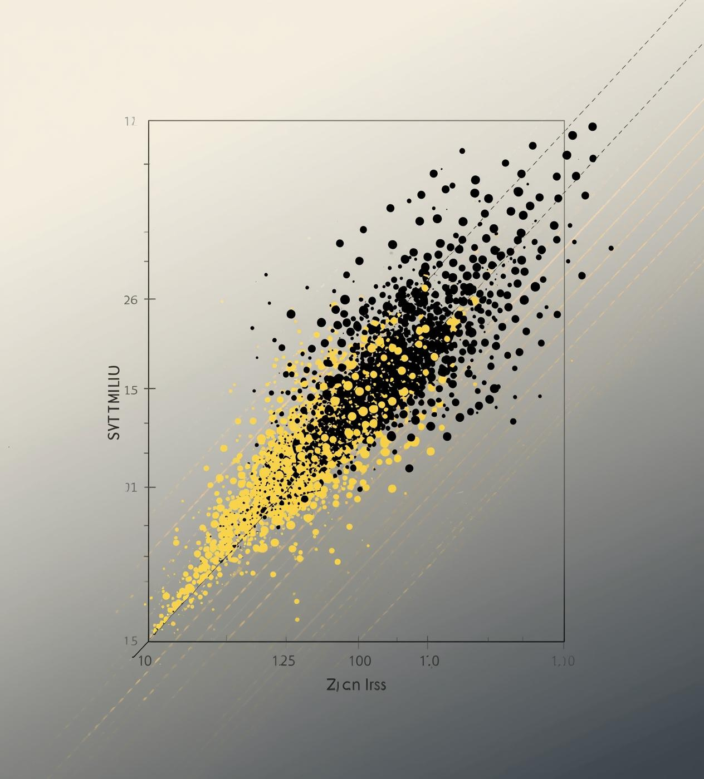
1
Instances of rare planets after SMOTE
After applying the SMOTE oversampling technique, we effectively increased the representation of rare planets in our dataset, achieving a balanced class distribution necessary for accurate classification.

Slide 8
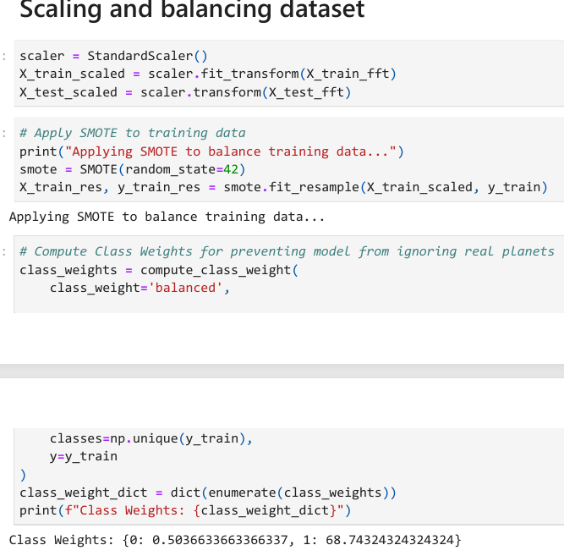
Handling Imbalanced Data
• Real planet samples are extremely rare.
• SMOTE used to oversample minority class.
• Class weights used to force model to pay attention to rare planets.
• Prevents model from predicting only ‘non-planet’.

Slide 9
Machine Learning Model Overview
Architecture of the Artificial Neural Network
• Sequential Artificial Neural Network.
• Layers:
• – Dense(1024) → LeakyReLU → BatchNorm → Dropout
• – Dense(512) → LeakyReLU → BatchNorm → Dropout
• – Dense(128) → LeakyReLU → Dropout
• Output: 1 neuron with sigmoid activation.
• Optimizer: Adam (low learning rate = 0.00005).
Architecture of the Artificial Neural Network
9

Slide 10
ANN Architecture and Setup
01
Architecture
03
Regularization
The model features an input layer and dense layers.
Batch Normalization and Dropout prevent overfitting.
02
Activation
04
Optimizer
LeakyReLU is used for hidden layer activation.
Adam optimizer with a low learning rate applied.

Slide 11
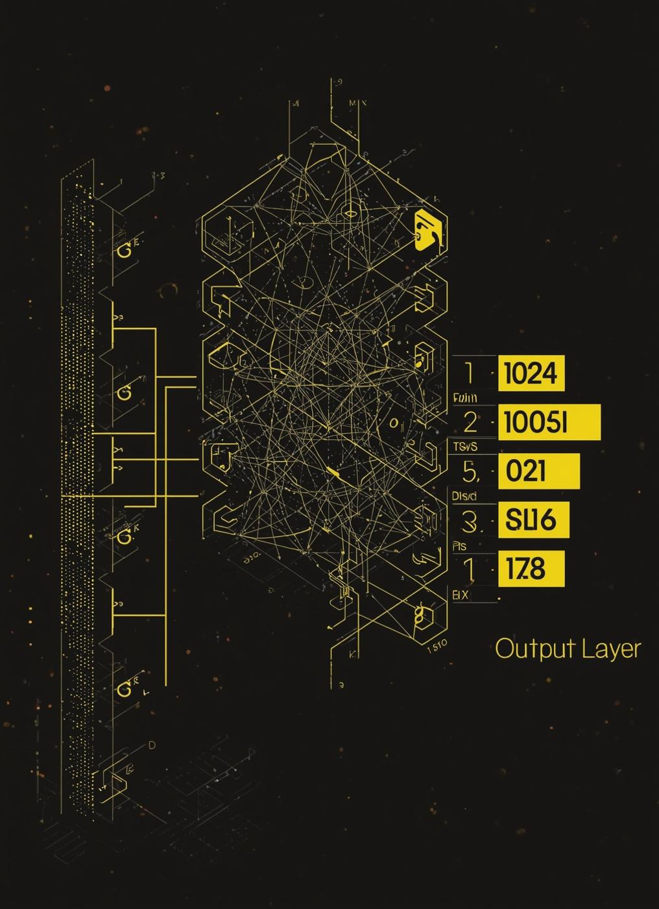
Loss Function Overview
Understanding Binary Crossentropy in ANN
Binary Crossentropy is the chosen loss function for our model, enabling effective classification of exoplanets by measuring the difference between predicted probabilities and actual labels, ensuring accurate learning.

Slide 12
Training Details and Trends
01
Training
03
Validation
The model was trained for 60 epochs.
Validation accuracy peaked early, indicating overfitting.
02
Accuracy
04
Threshold Tuning
Training accuracy showed gradual improvement over time.
Adjustments were made to balance true positives.

Slide 13
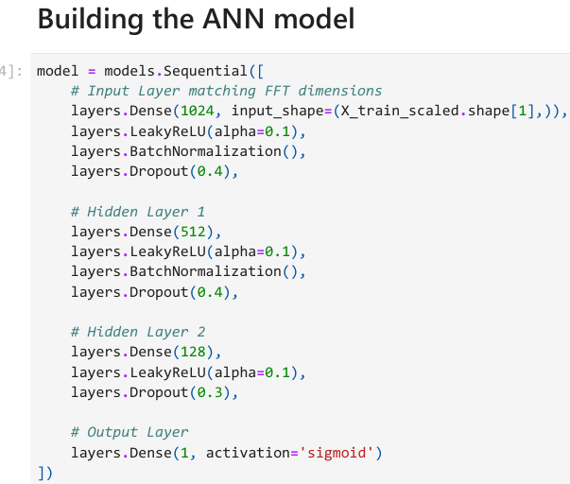
•
• Model trained for 60 epochs.
• Validation accuracy quickly reached 100%.
• Loss gradually reduced over time.
• Training stabilized well using batch normalization and dropout.
Training, Evaluation, and Results
Insights into Model Performance Metrics
Training Summary
13

Slide 14
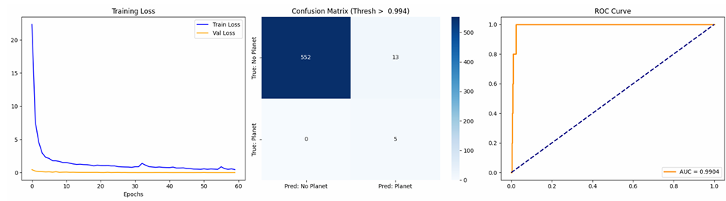
Evaluation Metrics
• Test Accuracy: ~97.72% at threshold 0.994.
• ROC-AUC Score: 0.9904.
• Confusion matrix shows very low false positives.
Recall for planets = 100% (no planets missed).

Slide 15
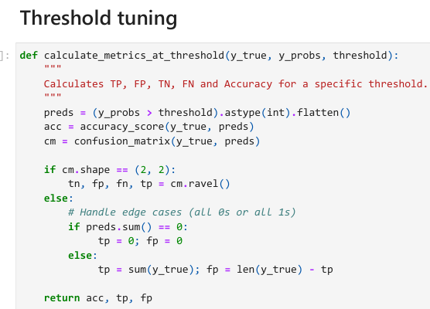
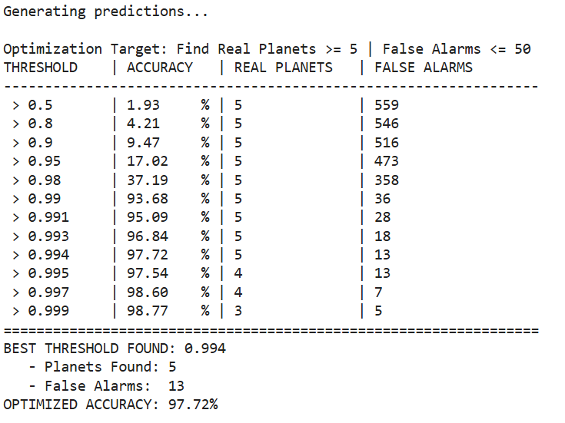
Threshold Optimization
• Tried thresholds from 0.5 to 0.999.
• Objective: Detect ≥5 planets with ≤50 false alarms.
• Best threshold found: 0.994.
• High accuracy maintained across thresholds.

Slide 16
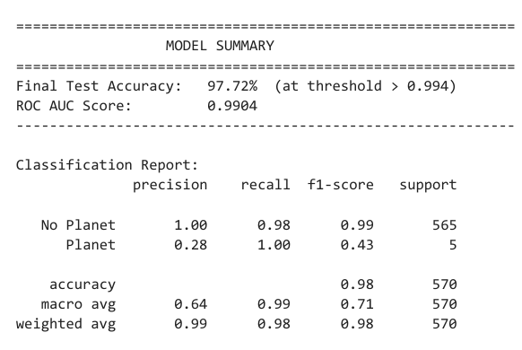
Final Results
• The model successfully classifies exoplanet candidates.
• High precision for non-planets.
• High recall for real planets.
• AUC close to 1.0 indicates strong predictive power.

Slide 17
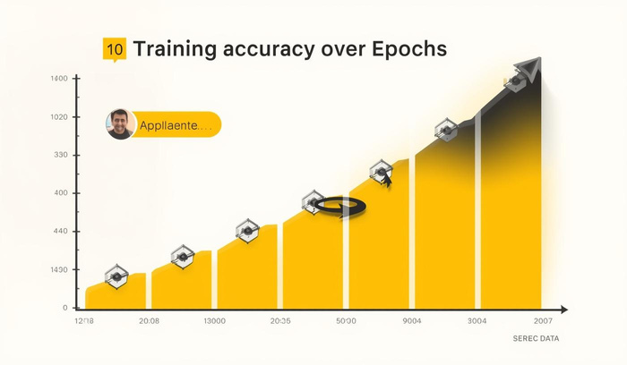
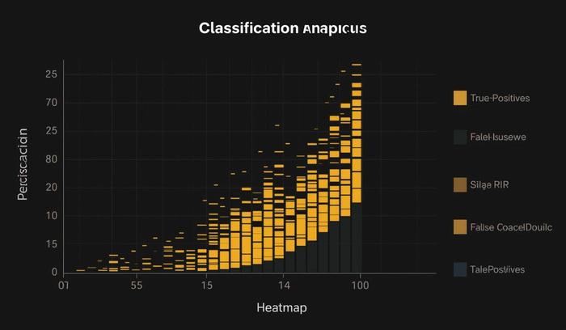
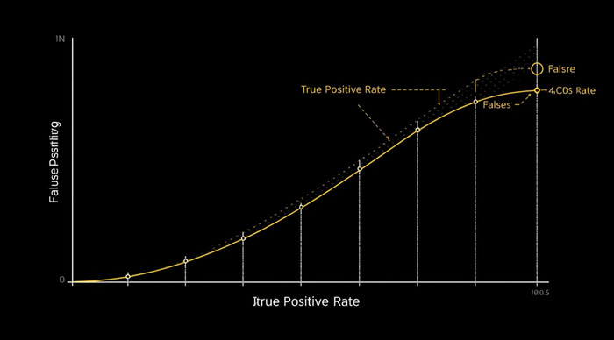
Key Metrics: Model Performance Overview
Accuracy
ROC AUC
The model achieved a remarkable accuracy of 97.7%.
The ROC AUC score reached an impressive 0.99.
Recall
Perfect recall of 1.0 ensures all planets detected.

Slide 18
Conclusion and Summary
Recap of Exoplanet Classification Insights
• FFT + Neural Networks provide strong detection capability.
• Balanced dataset & class weights greatly improve results.
• Model can be extended to multi-class exoplanet types.
• Supports automated exoplanet analysis for astronomy research.
18

Slide 19

Strengths and Challenges
01
High Recall
The machine learning model excels at detecting true planets, ensuring high recall rates. This strength allows for increased identification of exoplanets, vital for further astronomical studies.
02
False Positives
Despite its strengths, the model struggles with many false positives. This challenge necessitates ongoing refinement and validation within the classification process to improve overall accuracy.

Slide 20
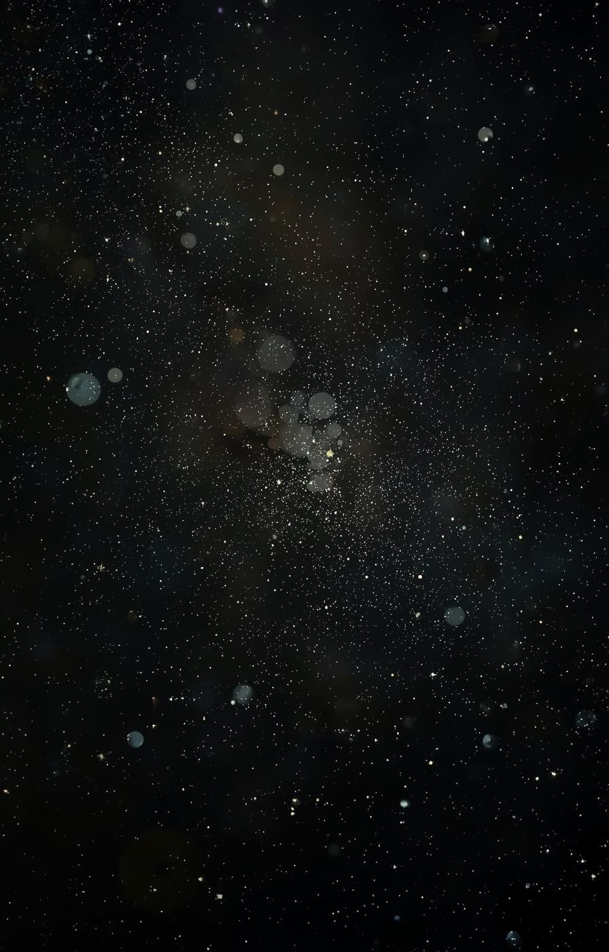
Thank You
Exploring ML in Astronomy

